Slide 1


Revised National Drug Policy & Malaria Treatment Guidelines 2010
Min of H & FW, GOI
Dr. Pradeep Kumar, MD, FIAPSM,
Professor & Head,
Community Medicine Dept.
GMERS Medical College, Sola, Ahmedabad
E mail: drpkumar_55@yahoo.com

Slide 2

Why now?

Slide 3
Introduction
Approx. 1.5 million confirmed cases annually (NVBDCP)
Pf on (40 - 50%) - due to
    use of CQ in Rx (resistant?).
    Non use of PQ
    Migration
18000 – 20000 die due to malaria every year (underestimates)
Curable if treatment started early, any delay may result serious consequences & death.

Slide 4
Resurgence of malaria
Increase in migration, urbanization
Poverty
Complacency in anti malarial programs
Deteriorating health system
Resistance to insecticides (vectors) & drugs (parasite)
Efficient transmission due to increased longevity/ breeding of vectors (global warming)

Slide 5
Clinical features Malaria
  cardinal symptom – Fever
  Intermittent (with/ out periodicity) or continuous.
  Accompanied with chills and rigors.
  Accompanied by headache, myalgia, arthralgia, anorexia, nausea, vomiting.
Suspected when
  From endemic areas &
  Presenting with above symptoms.
  Others include running nose, cough, diarrhea, burning micturition, abdominal pain, ear discharge, Lymphadenopathy

Slide 6
Early diagnosis & treatment (EDT) aims at
Complete cure (clinical & parasitological)
Prevent progression of uncomplicated malaria to severe (prevent mortality)
Prevention of relapse by giving radical treatment
Interruption of transmission (prevent new cases by gametocytocidal drugs)
Judicious use of drugs to minimize occurrence/ spread of drug resistance.

Slide 7
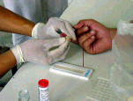
Diagnosis
Microscopy: Thick & thin blood smears
More sensitive & detect parasite at low densities & quantify parasitic load.
Also distinguish species & stages
Rapid Diagnostic Test (RDT) kits detects
Pf/ Pf & P vivax on the basis of
circulating parasitic antigens,
Ensure – kit kept at recommended temperature, within expiry period & user’s manual adhered
FINGER PRICK
RDT Kit

Slide 8
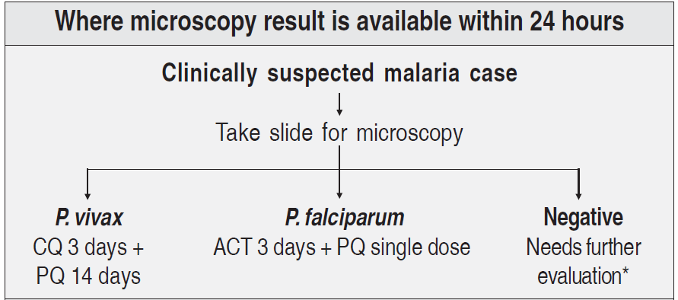
Algorithm for diagnosis and treatment of malaria

Slide 9
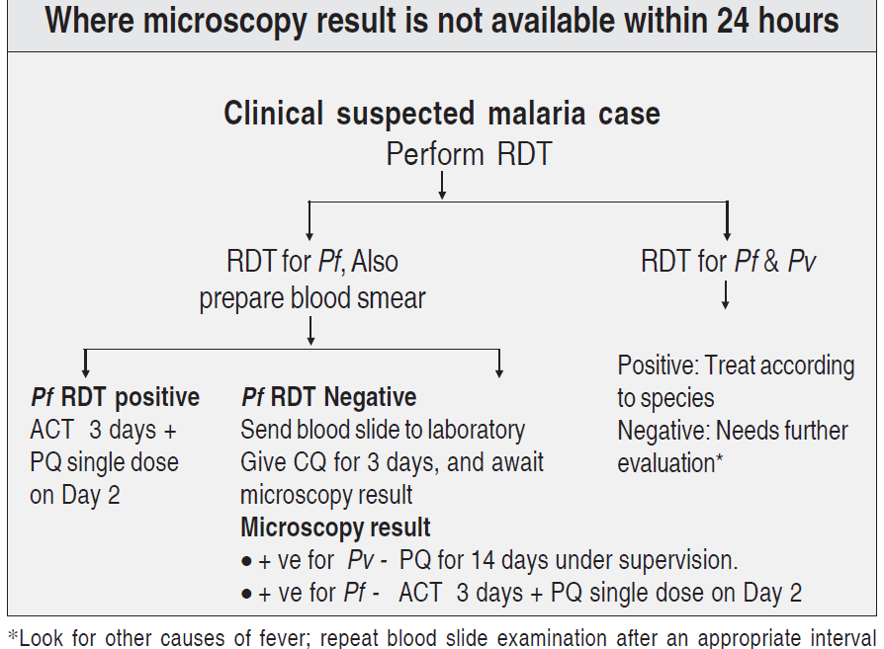
Algorithm for diagnosis and treatment of malaria

Slide 10
DO YOU KNOW?

Slide 11
Treatment of uncomplicated P. vivax malaria
Chloroquine 25 mg/kg divided over 3 days(10 +10+ 5).
Primaquine 0.25 mg/kg daily for 14 days.
Primaquine contraindicated in
  Infants
  Pregnant women &
  Known G6PD deficient patients - do test if available, Stop PQ if patient develops dark colored urine, yellow conjunctiva, blue discoloration of lips, nausea, vomiting or abdominal pain & report to doctor

Slide 12
Treatment of uncomplicated malaria (P. Vivax)
Age | Chloroquine (150 mg) |  |  | Primaquine (2.5 mg)
(years) | Day 1 | Day 2 | Day 3 | No. of tablets
< 1 | ½ | ½ | ¼ | Nil
1 – 4 | 1 | 1 | ½ | 1
5 – 8 | 2 | 2 | 1 | 2
9 – 14 | 3 | 3 | 1½ | 4
> 15 | 4 | 4 | 2 | 6
Primaquine given for 14 days in confirmed P vivax
Contraindicated in infants, pregnant women & patients with G6PD deficiency

Slide 13
Treatment of uncomplicated malaria P. falciparum
All cases confirmed by microscopy/ RDT should get
Artemisinin Combination Therapy (ACT) – Artesunate (4 mg/ Kg BW)/ day for 3 days & SP (Sulphadoxine – 25 mg/Kg BW & Pyremethamine 1.25 mg/Kg BW) single dose - day 0 &
Primaquine single dose (0.75 mg/kg BW) on 2nd Day.
Oral artemisinin monotherapy banned - can lead to drug resistance.

Slide 14
Treatment of uncomplicated malaria (P. falciparum)
Age (years) |  | Number of tablets For AS & SP |  |  | Primaquine (7.5 mg)
 |  | Day 1 | Day 2 | Day 3 | Day 2
<1 | AS SP | ½ ¼ | ½ Nil | ½ Nil | Nil
1 – 4 | AS SP | 1 1 | 1 Nil | 1 Nil | 1
5 – 8 | AS SP | 2 1½ | 2 Nil | 2 Nil | 2
9 – 14 | AS SP | 3 2 | 3 Nil | 3 Nil | 4
15 & above | AS SP | 4 3 | 4 Nil | 4 Nil | 6
AS – Artesunate 50 mg, SP – Sulphadoxine 500 mg + Pyremethamine 25 mg

Slide 15
Treatment of mixed infections
Mixed infections with Pf should be treated as falciparum malaria.
Anti-relapse treatment with Primaquine to be given for 14 days.
Treatment of malaria in pregnancy
Pf cases: ACT in 2nd & 3rd trimesters & quinine in 1st trimester (if quinine NA, use ACT).
P. vivax treated with Chloroquine in all trimesters.
No anti relapse treatment (Primaquine)

Slide 16
General recommendations
Avoid treatment on an empty stomach.
First dose under observation & repeat if vomiting occurs within 30 minutes.
Ask to report back, if no improvement after 48 hrs or situation deteriorates (Not responding to treatment).
Also examine for concomitant illnesses.

Slide 17
Chemoprophylaxis
Recommended for
Travellers to endemic areas,
Migrant labourers &
Military personnel exposed to highly endemic areas.
Chloroquine no longer considered effective for Pf in India; not used for chemoprophylaxis.
Pregnancy: It is not recommended now & use of personal protection measures (ITBN, Repellents etc) are encouraged.

Slide 18
Short-term chemoprophylaxis (< 6 weeks)
Doxycycline: 100 mg daily in adults and 1.5 mg/kg body weight for children > 8 years old for < 8 years Clindamycin used.
Drug is started 2 days before travel & continued for 4 weeks after leaving the malarious area.
Contraindicated in pregnant/ lactating women & children < 8 years.

Slide 19
Long-term chemoprophylaxis (> 6 weeks)
Mefloquine:
5 mg/kg BW (up to 250 mg) weekly
To be taken 2 weeks before, and till 4 weeks after leaving the area.
Contraindicated in cases with H/O convulsions, neuropsychiatric and cardiac conditions.

Slide 20
Treatment Failure/ drug resistance: “Cure” if no fever & parasitemia till 28 days otherwise - Treatment Failure/ drug resistance
1. Early treatment failure (ETF)
Development of danger signs/ severe malaria on Day 1, 2 or 3, in presence of parasitemia, or
Parasitaemia on Day 2 higher than Day 0, irrespective of axillary temperature, or
Parasitaemia on Day 3 with axillary temperature > 37.5°C, or
Parasitaemia on Day 3, >25% of count on Day 0 irrespective of axillary temperature,

Slide 21
2. Late clinical failure (LCF)
Development of danger signs or severe malaria in the presence of parasitaemia on any day between Day 4 and Day 28 (42) or
Presence of parasitaemia on any day between Day 4 and Day 28 (42) with axillary temperature > 37.5°C.
provided it did not meet criteria of ETF
3. Late parasitological failure (LPF)
Presence of parasitemia any day between 7 - 28 Days irrespective of axillary temperature
Such cases should get alternative ACT or quinine with Doxy

Slide 22
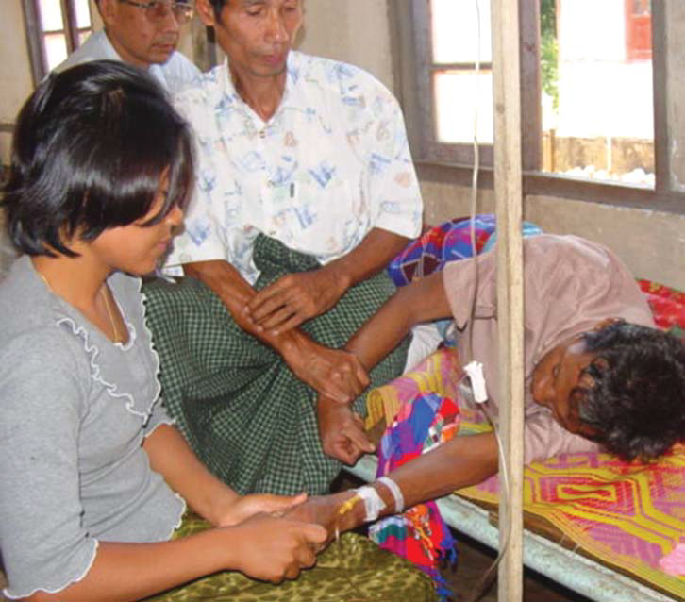
Severe Malaria & its management

Slide 23
Severe malaria
Develops in Pf cases even within 12 hours & may be fatal.
Clinical features
Impaired consciousness/unrousable coma
Repeated generalized convulsions (> 2 in 24 hrs)
Prostration (generalized weakness –patient unable walk/sit up without assistance)
Renal failure (Serum Creatinine > 3 mg/dl)
Clinical Jaundice (Serum Bilirubin > 3 mg/dl) plus evidence of other vital organ dysfunction

Slide 24
Clinical features….cont.
Severe Normocytic anaemia
(Hb < 5 g/dl or PCV < 15%).)
7. Pulmonary oedema/ ARDS (radiological).
8. Hypoglycaemia (Plasma Glucose < 40 mg/dl)
Metabolic acidosis (plasma bicarbonate < 15 mmol/l)
Circulatory collapse/shock (SBP <70 mm Hg, <50 mm Hg in children)
Abnormal bleeding & DIC

Slide 25
Clinical features….cont.
Haemoglobinuria
Hyperlactataemia (lactate > 5 mmol/l).
Hyperpyrexia (Temperature > 106º F or > 42º C)
Hyperparasitaemia (> 5% RBCs parasitized )
Foetal/ maternal complications are more in pregnancy
All complication should be managed as acute emergencies along with anti malarial treatment

Slide 26
Severe malaria negative on microscopy
May be negative due to low parasitemia, sequestration in vessels & partial treatment
Poor microscopy
Confirm by RDT or repeat microscopy.
Clinical presentation if indicative of severe malaria & no alternative explanation, treat accordingly.

Slide 27
Specific Antimalarials in severe malaria
Parenteral artemisinin derivatives or quinine to be used irrespective of Chloroquine sensitivity.
Artesunate: 2.4 mg/kg BW, IV/ IM on admission, at 12 hrs & 24 hrs, then once a day (dilute in 5% Soda bi-carb).
Artemether: 3.2 mg/kg BW, IM on admission then 1.6 mg/kg BW per day.
α−β Arteether: 150 mg daily IM for 3 days in adults (not in children).

Slide 28
Specific Antimalarials of severe malaria cont.
Quinine: 20 mg quinine salt/kg BW on admission (IV infusion in 5% dextrose/dextrose saline over 4 hours) followed by maintenance dose of 10 mg/kg BW, 8 hourly; @ 5 mg/kg BW per hour.
NEVER GIVE BOLUS INJECTION OF QUININE.
If Parenteral quinine continued beyond 48 hours, dose is reduced to 7 mg/kg BW 8 hourly.
IV preparations preferred over IM & once started, Parenteral treatment given minimum for 24 hrs.

Slide 29
Once patient take oral therapy – FU treatment
Patients receiving Parenteral quinine - treat with oral quinine 10 mg/kg BW 3 times a day to complete course of 7 days, along with Doxycycline 3 mg/ kg BW per day for 7 days.
Doxycycline contraindicated in pregnant women/ children < 8 years; instead, Clindamycin 10 mg/kg BW 12 hourly for 7 days used.
Severe malaria caused by P. vivax
Treated like severe malaria due to Pf.

Slide 30
Think beyond clinical cure
While clinical cure achieved with appropriate schizonticidals, gametocytes sucked by vector develop in to disease causing sporozoites which through mosquito bite are again transmitted to healthy person leading to another malaria case.
This can be prevented by gametocytocidal drugs (Primaquene)

Slide 31
Take home messages - 1
“Use of gametocytocidal drug should be a part of standard treatment whenever a case is treated”.
Use contact with patient/ attendants to give IEC & preventive education for
  Treatment
  Prevention of vector bite
Collect contact details (address & mobile number) as line list is given to AMC staff to check
  whether treatment is completed &
  other measures are taken.

Slide 32
Take home messages - 2
Information of all fever/ malaria cases
(IPD or OPD) be collected as per annexure B
5. Any suspected treatment failure should be reported to office of CDMO & PSM Dept. – to be forwarded to RO H & FW (GOI) for study of drug resistance
6. Any death due to malaria be investigated & annexure D must be filled/ reported in consultation with PSM dept.

Slide 33
Thanks

